Slide 1

Smart neighborhood system for shutters management
Baraldi Francesco, Pagliani Matteo

Slide 2
Outline
Introduction
Architecture
Prototype specifications
Reinforcement learning approach
Video Demo

Slide 3
Introduction

Slide 4
Introduction
Too lazy to close the shutters in case of a thunderstorm?
Do you often forget to close the shutters before falling asleep?
Or do your flowers need sunlight when you are on holiday away from home?
→ This system is the answer for you! Our product automatically open or close the shutters of houses depending on weather conditions. Its scalability allows it to be used not only by you, but also by your neighbours, aiming to control the shutters of several houses in your neighbourhood simultaneously.

Slide 5
How to use
You don’t have to worry about anything, the system takes care of your house for you:
When specific weather conditions trigger our system, it will take a decision about closing or opening the shutters in total autonomy. You will be notified directly on your smartphone when a decision is taken, and you can feed back if you liked that decision or not, giving us the possibility to improve based on your habits! The system learns how to perfectly fit your needs
When you are away, you can always control the shutters remotely via web
Obviously, you can control the shutters manually thanks to specific buttons installed in your house
The system takes into account your neighbours action to make better decisions on your own windows

Slide 6
Composition of the kit
The kit is composed by:
1 internal kit per house: a microcontroller, an actuator and a button for each of the windows you want to control
1 external kit per neighbourhood: some sensors (a photoresistor and a wind speed sensor) and a control unit for the whole neighbourhood, which will be installed in a strategic position close to the houses to be managed
Finally you shall install the Telegram application on your smartphone and keep on hand the web site for optimal control.

Slide 7
Key points: why chosing our system?
Because it is:
Easy to setup
Not invasive
Automatic
Flexible
Scalable
Adaptive to users’ habits

Slide 8
Architecture

Slide 9
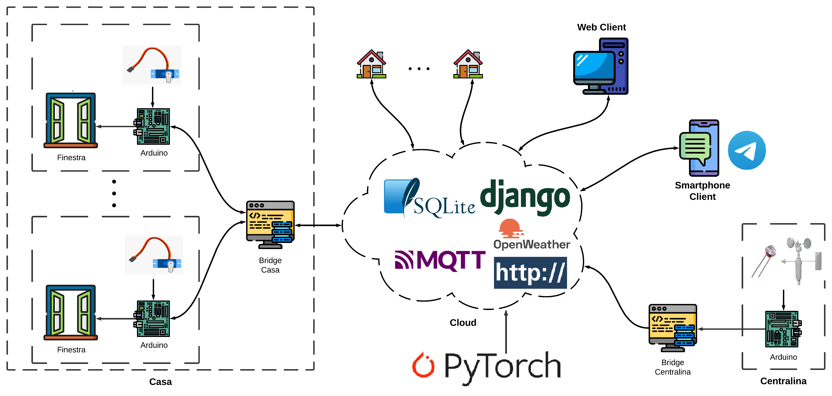
Architecture: real model

Slide 10
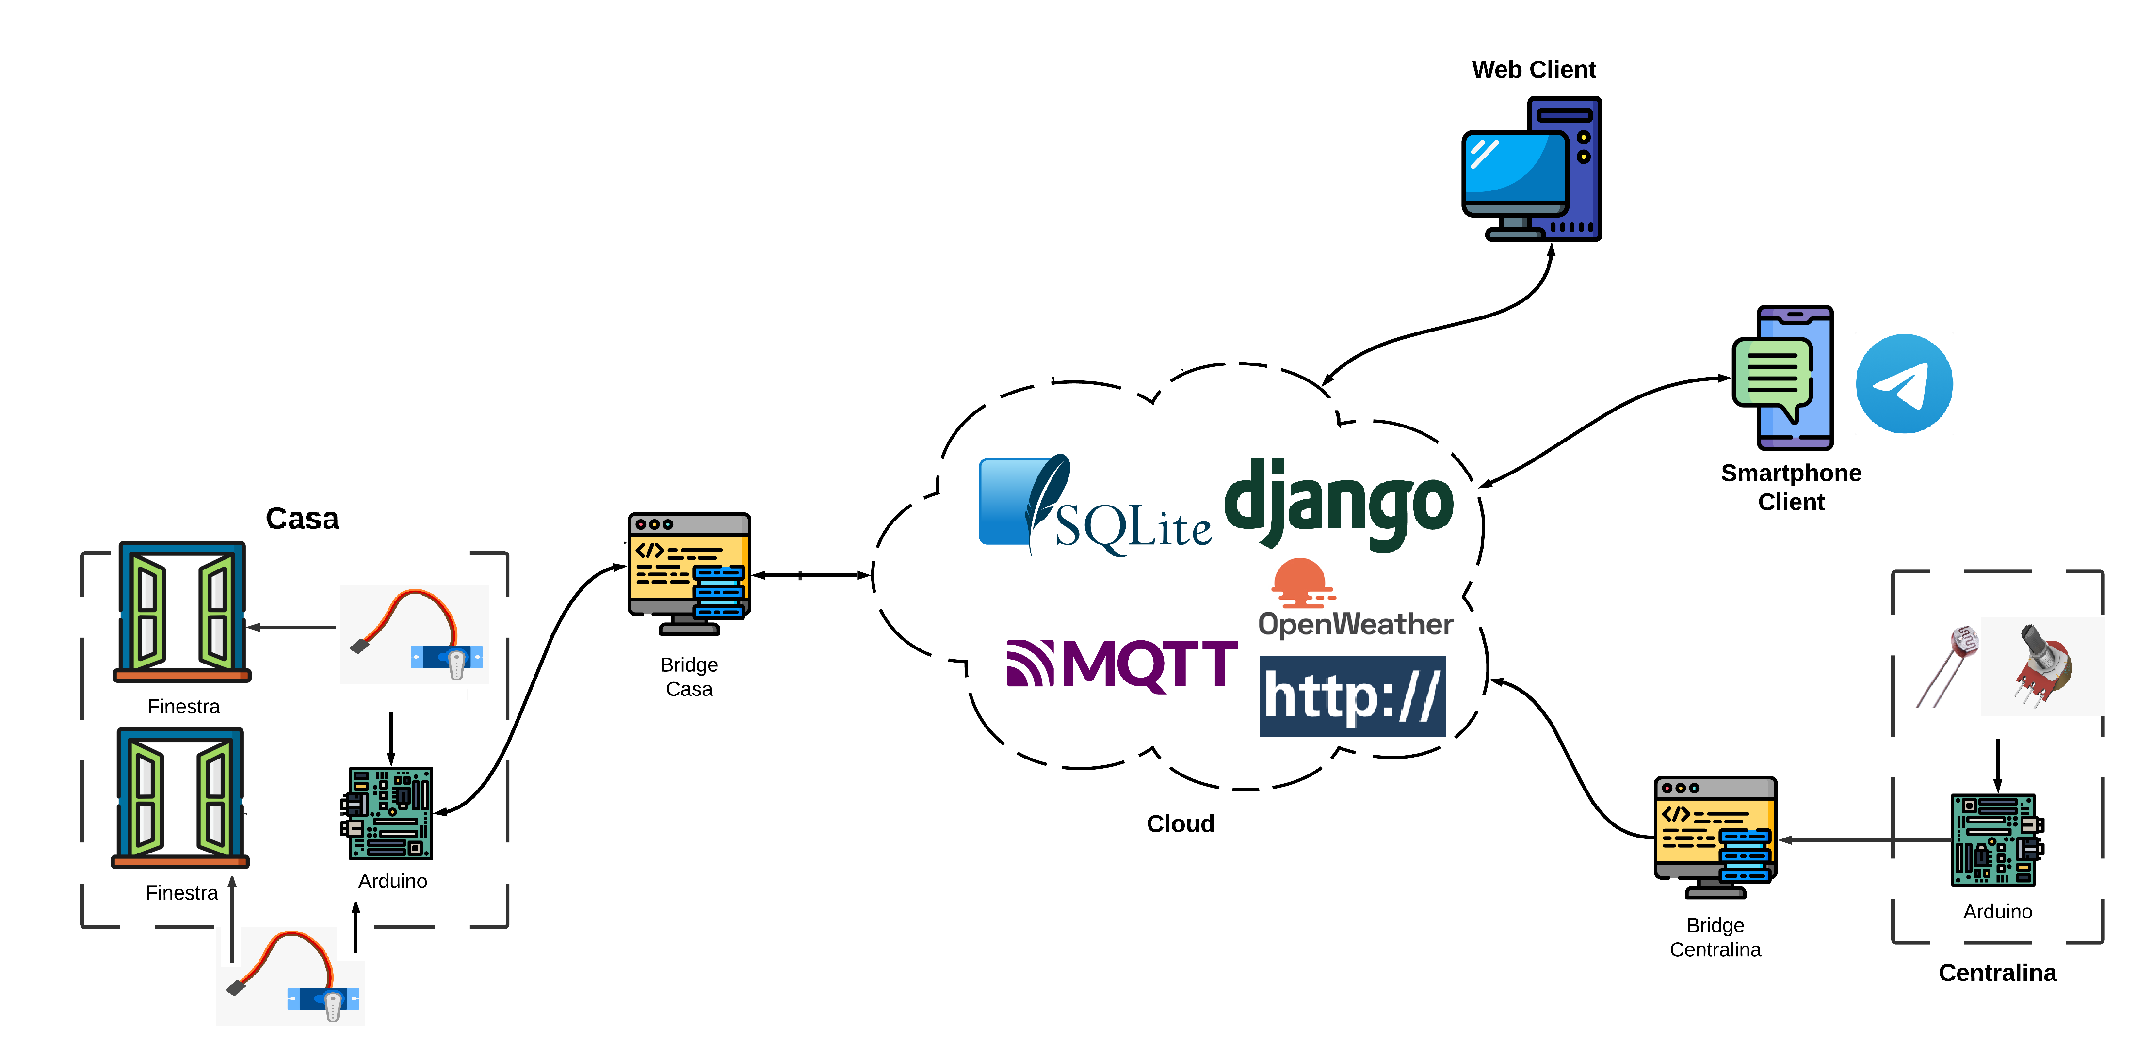
Architecture: prototype

Slide 11
Prototype specifications

Slide 12
Real model vs prototype
Real Model | Prototype
1 Arduino Nano for each window | 1 Arduino UNO Rev.3 for two windows
1 Raspberry Pi for each house which manages all the house’s windows and runs the internal bridge | Laptop as internal bridge
1 Raspberry Pi for each neighborhood that runs the external bridge | Laptop as external birdge
Server Django and engine hosted with a public IP | Server Django and engine running in localhost
Prettier buttons | Push buttons
1 custom actuator for each window | 1 servomotor for each window (Hitec and TowerPro)
Wind speed sensor | 1 potentiometer as wind speed sensor
Proper web app frontend for improved UE | Simple web app using Django template
Reinforcement learning approach in case of uncertain situations | Neighbours “control” in case of uncertain situations

Slide 13
Prototype specifications
Connection schemas, sensors and actuators
FSM for push buttons
Code tables for serial communication
Web App
Database structure
Telegram bot
OpenWeather APIs
Neighbours “control” in case of uncertain situations

Slide 14
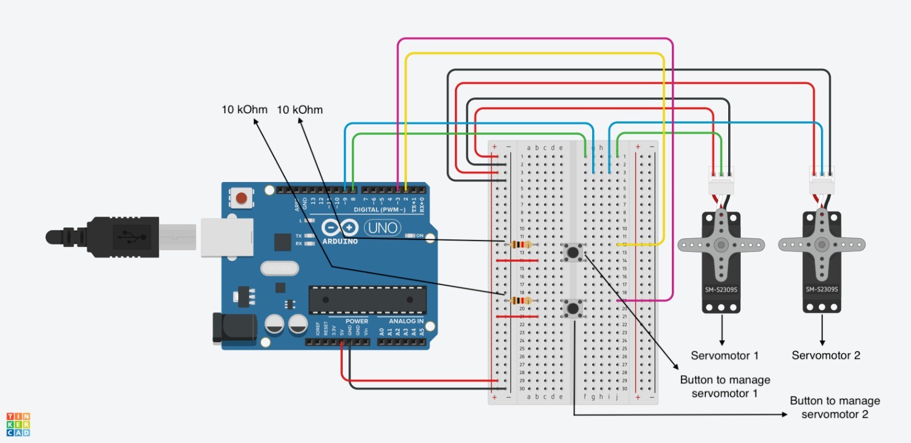
Connection schemas
The Arduino Uno for the internal kit is connected to:
1 Hitec servomotor
1 TowerPro servomotor
2 push buttons

Slide 15
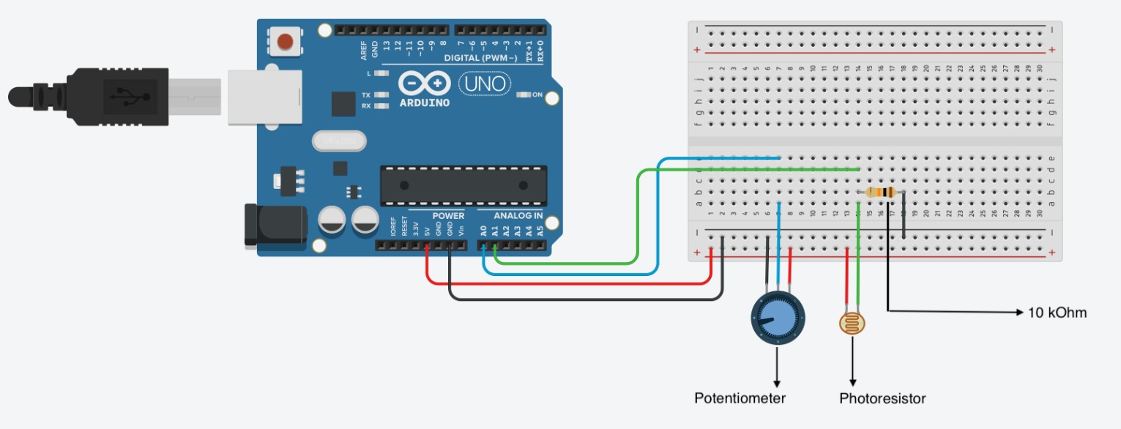
Connection schemas (1)
The Arduino Uno for the external kit is connected to:
1 photoresistor
1 potentiometer

Slide 16
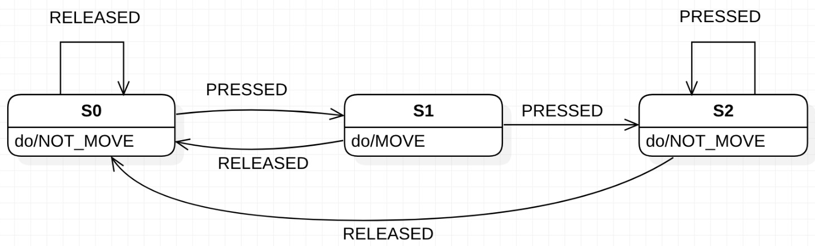
FSM for push buttons
States: {S0, S1, S2}
S0: initial state
S1: button pressed
S2: button pressed more than one time consecutively
Inputs: {PRESSED, RELEASED}
PRESSED : high (5V) digital signal due to the button pression
RELEASED : low (0V) digital signal due to the button release
Outputs: {MOVE, NOT_MOVE}
MOVE: allows the servo to change the state of the window (from open to closed or viceversa)
NOT_MOVE: does not allow the servo to change the state of the window

Slide 17
Code tables for serial communication between «internal» Arduino and its bridge
0xFF | 0x01 | WINDOW_PIN | 0xFE
Header | Payload length | Payload | Footer
Header (1 byte): identifies the beginning of the packet
Payload length (1 byte): specifies the byte length of the payload
Payload (1 byte): the microcontroller writes on the serial bus the number of the pin connected to the servomotor whose window has just changed state. The bridge will read from the serial and will update accordingly in the database the state of the window.
Footer (1 byte): identifies the end of the packet

Slide 18
Code tables for serial communication between «external» Arduino and its bridge
0xFF | 0x02 | Potentiometer value | Photoresistor value | 0xFE
Header | Payload length | Payload | Payload | Footer
Header (1 byte): identifies the beginning of the packet
Payload length (1 bytes): specifies the byte length of the payload
Payload (2 byte): the first and the second byte are respectively the value read by the potentiometer and the value read by the photoresistor, both mapped from the original range 0 – 1024, to the range 0 – 253 in order to store them in exactly one byte
Footer (1 byte): identifies the end of the packet

Slide 19
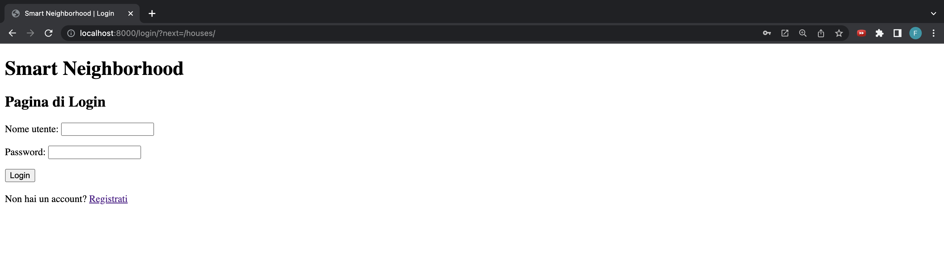
Web App – Login Page

Slide 20
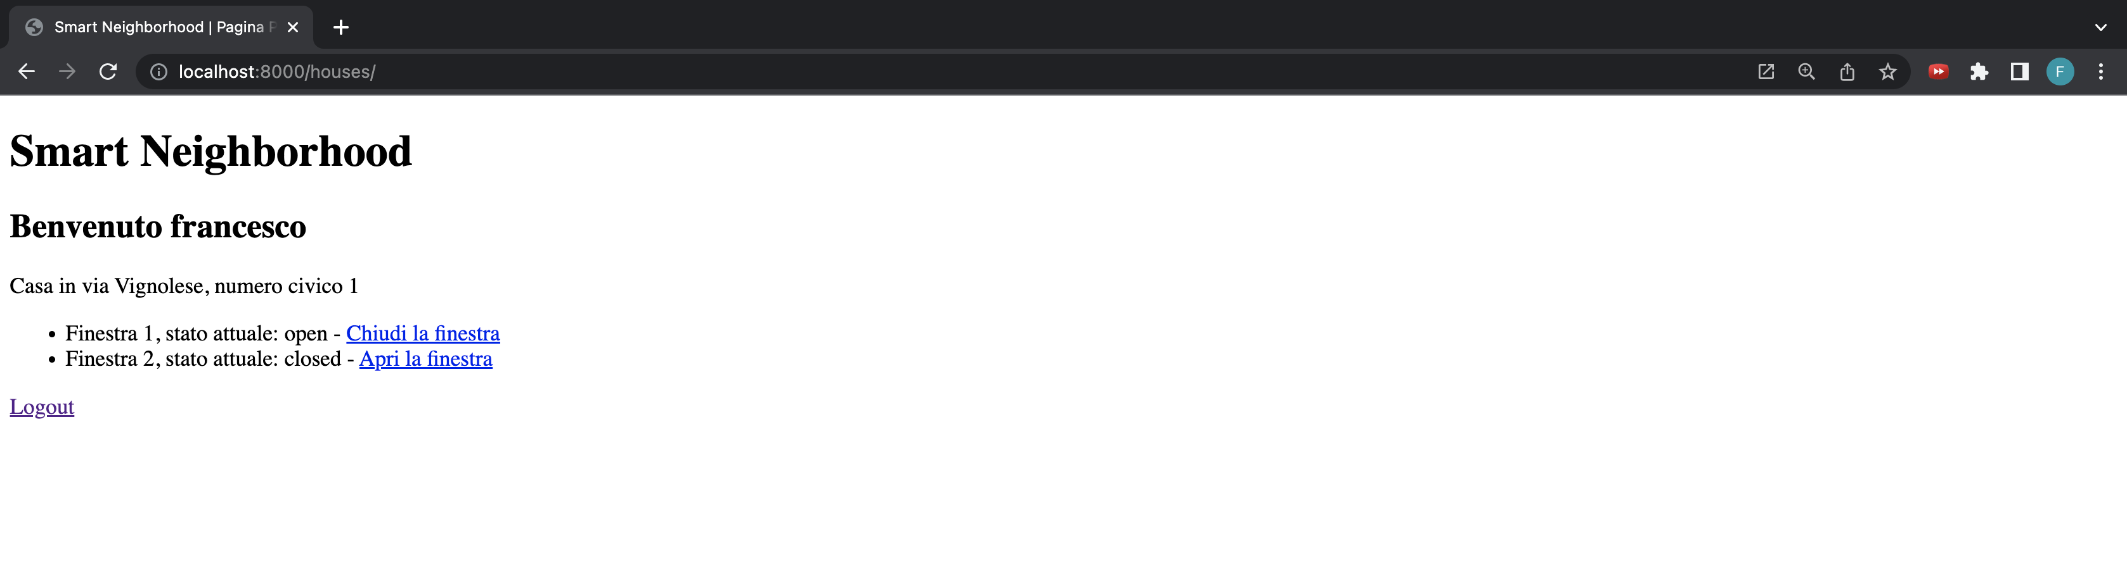
Web App – Home Page

Slide 21
Telegram bot
A Telegram bot named smart_neighborhood is used to notify the house’s owners whenever the system decides to move the windows autonomously. The bot has two simple commands: /start that is automatically called when the bot is started, which gives a welcome message and store, if new, the user in the database; /help which gives a short description of the bot’s functionality.
When the engine decides to move the windows, it calls a specific function of the bot which sends a message to all the chat ids stored in the database in order to make the owners aware of the new state of their windows. In the message is also suggested to use the web app to change the state of the windows if the new one does not match the user’s will.

Slide 22
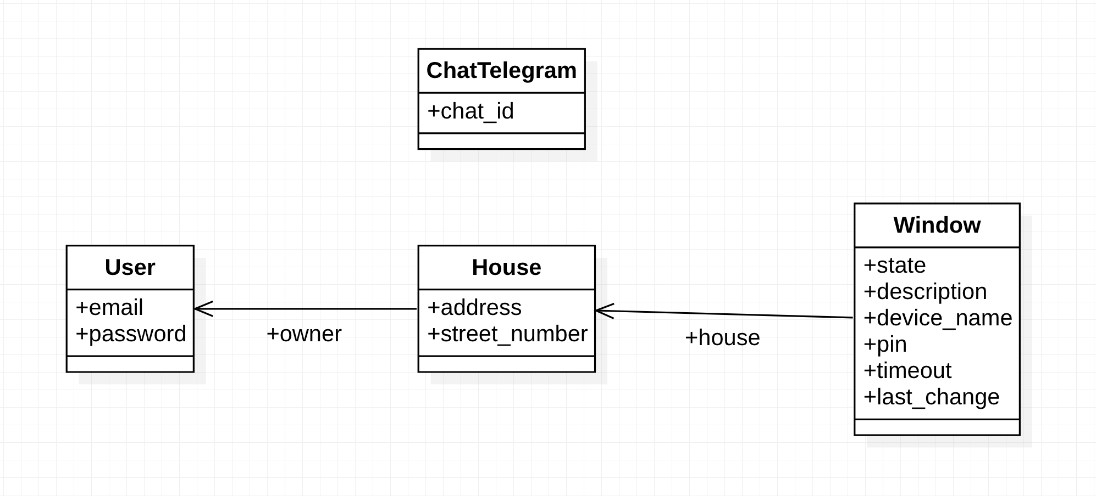
SqLite3 database structure

Slide 23
SqLite3 database structure (1)
The database is automatically managed by Django using the model part of the MVC approach: we define a python class for each DB table and Django creates the respective relational DB. The 4 classes are described below:
ChatTelegram: it represents a Telegram chat identified by the chat_id;
User: it represents a user and is managed automatically by Django authentication system. It has a unique email and a password;
House: it models an house where the system is installed. It’s described by the address and the street number and it is associated with a User object which represents the owner of the house;
Window: it is a generic window object, each one is associated with a house and has a current state (closed or open), a text description, a device name (identifier for the Arduino that manages this specific window) and a pin (the pin number connected to the actuator in the Arduino board), a timeout (a boolean field which says if the window can be moved autonomously by the system or not) and finally a date which represents the last_change timestamp.

Slide 24
OpenWeather APIs
The data retrieved from the OpenWeather APIs are the current temperature and weather condition: the latter is categorized with different codes, each of them assigned to a close/open/ambiguous condition in order to process the information and take the correct decision. These are the categories:
Group 2xx: thunderstorm, we consider it as a close condition;
Group 3xx: drizzle, we consider it as an ambiguous condition;
Group 5xx: rain, we consider it as a close condition;
Group 6xx: snow, we consider it as a close condition;
Group 7xx: atmosphere, we consider it as an open condition;
Value 800: clear, we consider it as an open condition;
Group 80x: clouds, we consider it as an ambiguous condition.

Slide 25
Decision logic
The system decides to open or close the windows depending on the condition of each parameter’s value: temperature, wind, lightness and weather condition. For each of them there are three range of possible values, on for a close condition, one for an open condition, and one for an ambiguous condition. The decision is taken as follows:
If at least 2 values are in the open condition then open the windows.
If at least 3 values are in the close condition then close the windows.
If none of the previous, then there is an ambiguous condition, in this case a neighborhood control system is used in order to take the best decision.

Slide 26
Neighbourhood control
In case of uncertain situations, for example …, we look at neighbours decisions.

Slide 27
Reinforcement learning approach

Slide 28
Vanilla Q-Learning
The “vanilla” Q-Learning uses a Q-table that maps a state-action pair to a Q-value (the estimated maximum future reward) which the agent will learn. The Q-table is initialized to all zeros indicating that the agent doesn’t know anything about the world. As the agent tries out different actions at different states through trial and error, the agent learns each state-action pair’s expected reward and updates the Q-table with the new Q-value. Using trial and error to learn about the world is called exploration. After an agent has learned the Q-value of each state-action pair, the agent at state S maximizes its expected reward by choosing the action A with the highest Q-value. Choosing the best known action at state S is called exploitation.

Slide 29
Vanilla Q-Learning (1)
A common strategy for tackling the exploration-exploitation tradeoff is the Epsilon Greedy Exploration Strategy.
At every time step when it’s time to choose an action, roll a dice
If the dice has a probability less than epsilon, choose a random action
Otherwise take the best known action at the agent’s current state
Note that at the beginning of the algorithm, every step the agent takes will be random which is useful to help the agent learn about the environment it’s in. As the agent takes more and more steps, the value of epsilon decreases and the agent starts to try existing known good actions more and more. Note that epsilon is initialized to 1 meaning every step is random at the start. Near the end of the training process, the agent will be exploring much less and exploiting much more.

Slide 30
Vanilla Q-Learning (2)
The Bellman Equation tells us how to update our Q-table after each step we take. To summarize this equation, the agent updates the current perceived value with the estimated optimal future reward which assumes that the agent takes the best current known action. In an implementation, the agent will search through all the actions for a particular state and choose the state-action pair with the highest corresponding Q-value.
S = the State or Observation
A = the Action the agent takes
R = the Reward from taking an Action
t = the time step
Ɑ = the Learning Rate
ƛ = the discount factor which causes rewards to lose their value over time so more immediate rewards are valued more highly

Slide 31
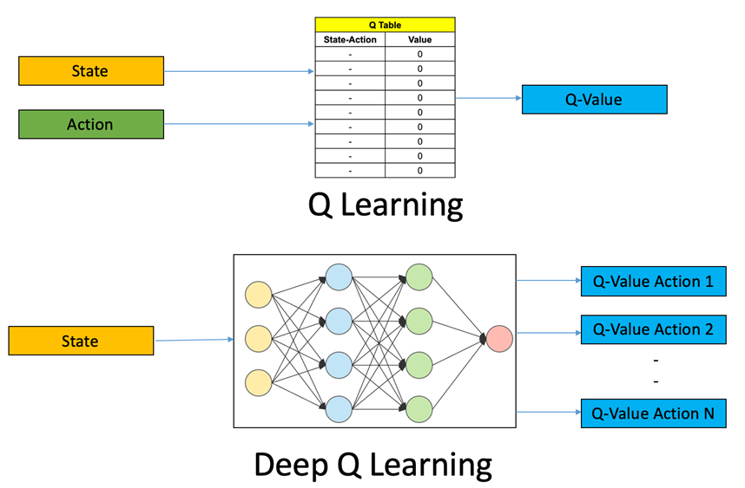
DQN
DQN (Deep Q-Learning Networks) is a model-free reinforcement learning algorithm in which a neural network maps input states to (action, Q-value) pairs.
Initialize your Main and Target neural networks
Choose an action using the Epsilon-Greedy Exploration Strategy
Update your network weights using the Bellman Equation

Slide 32
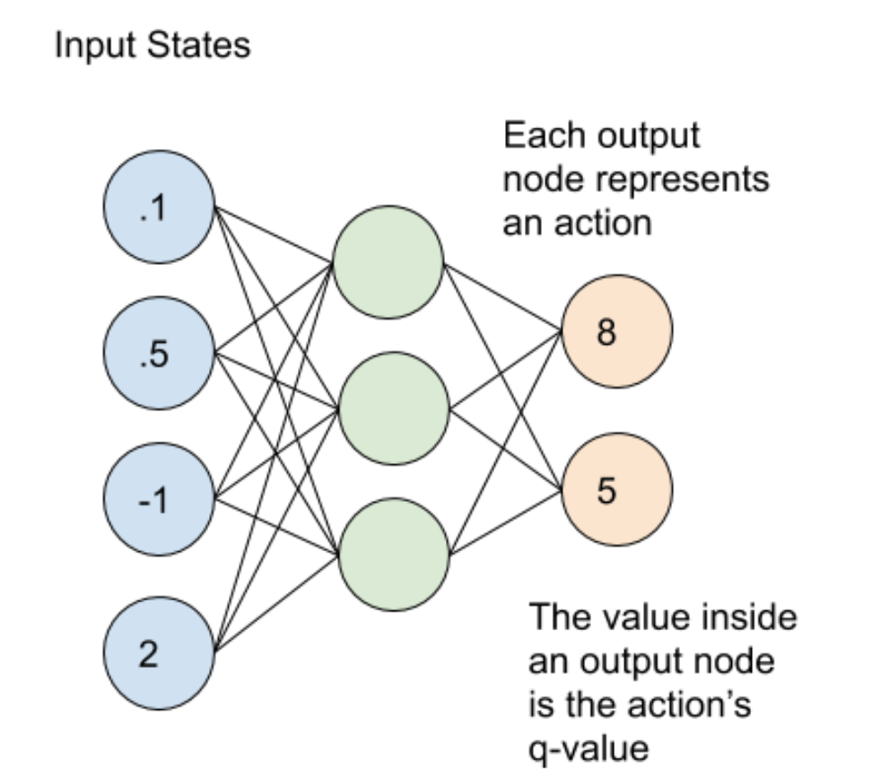
DQN (1)
The learning process uses 2 neural networks. These networks have the same architecture but different weights. Every N steps, the weights from the main network are copied to the target network. Using both of these networks leads to more stability in the learning process and helps the algorithm to learn more effectively. In our implementation, the main network weights replace the target network weights every 100 steps.
The main and target neural networks map input states to an (action, q-value) pair. In this case, each output node (representing an action) contains the action’s q-value as a floating point number. Note that the output nodes do not represent a probability distribution so they will not add up to 1. For the example above, one action has a Q-value of 8 and the other action has a Q-value of 5.

Slide 33
DQN implementation ideas

Slide 34
Video DEMO?

